Slide 1
Robert Ricci

Slide 2
Clouds have been transformative
Clouds are great!
… except when they’re not
Lots of opportunities for research

Slide 3
CloudLab enables research on the future of cloud computing architectures and the new applications they enable

Slide 4
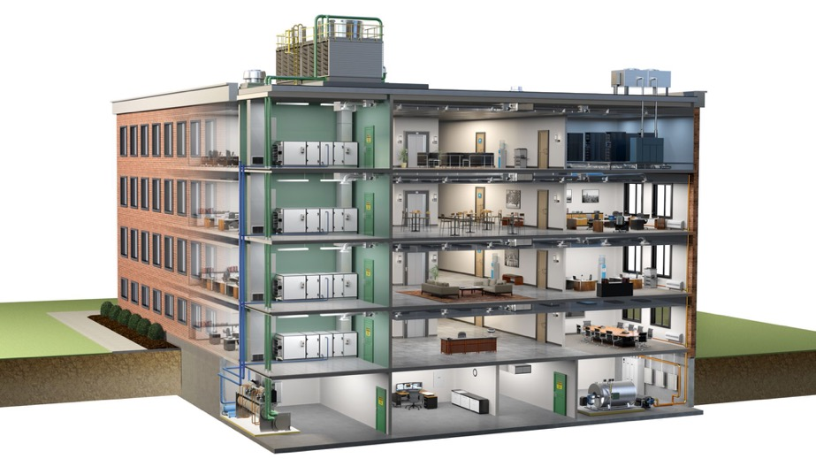
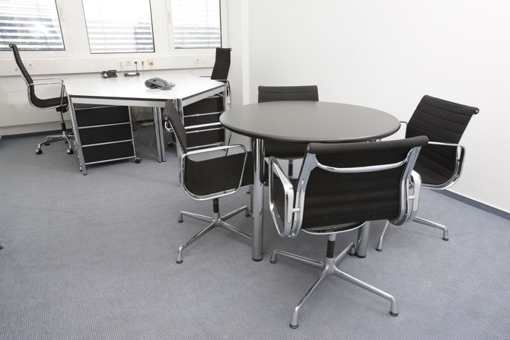
The Problem with Working on Clouds

Slide 6
The CloudLab Vision
A “meta-cloud” for building clouds
Build your own cloud on our hardware resources
Run any cloud software
Control and visibility all the way to the bare metal
“Sliceable” for multiple, isolated experiments at once
With CloudLab, it’s as easy to get an entire cloud as it is to get a VM in a cloud

Slide 7
= GENI racks

Slide 8
CloudLab’s Hardware
One facility, one account, three locations
Total: 1,770 nodes (25,652 cores)
Separate networks for control and experiment
>1,000 ports of hardware OpenFlow switching
Bare-metal, exclusive access, full control
Interconnected at 100 Gb w/ Internet2 AL2S
Federated with GENI, Emulab, Powder
Wisconsin
Clemson
Utah
Storage and networking
527 nodes (10,124 cores)
HDD and SSD
Nodes with up to 8 disks
GPUs, including w/ 4 GPUs
10 Gbps Ethernet
Clos network topology
All x86
HW from Cisco and HP
Scale-up and HPC
266 nodes (6,880 cores)
More RAM/cores per server
GPUs
Nodes w/ up to 47 HDDs
10 Gbps Eth./40 Gbps IB
‘Fat core’ network
x86 and IBM POWER8
HW from Dell and IBM
Scale-out and networking
977 nodes (8,728 cores)
HDD, SSD, and NVMe
Power monitoring
Layer-1 topology control
Programmable switches
10/25/40 Gb Eth./56 Gbps IB
x86 and ARM64
HW from HP, Dell, Mellanox

Slide 9
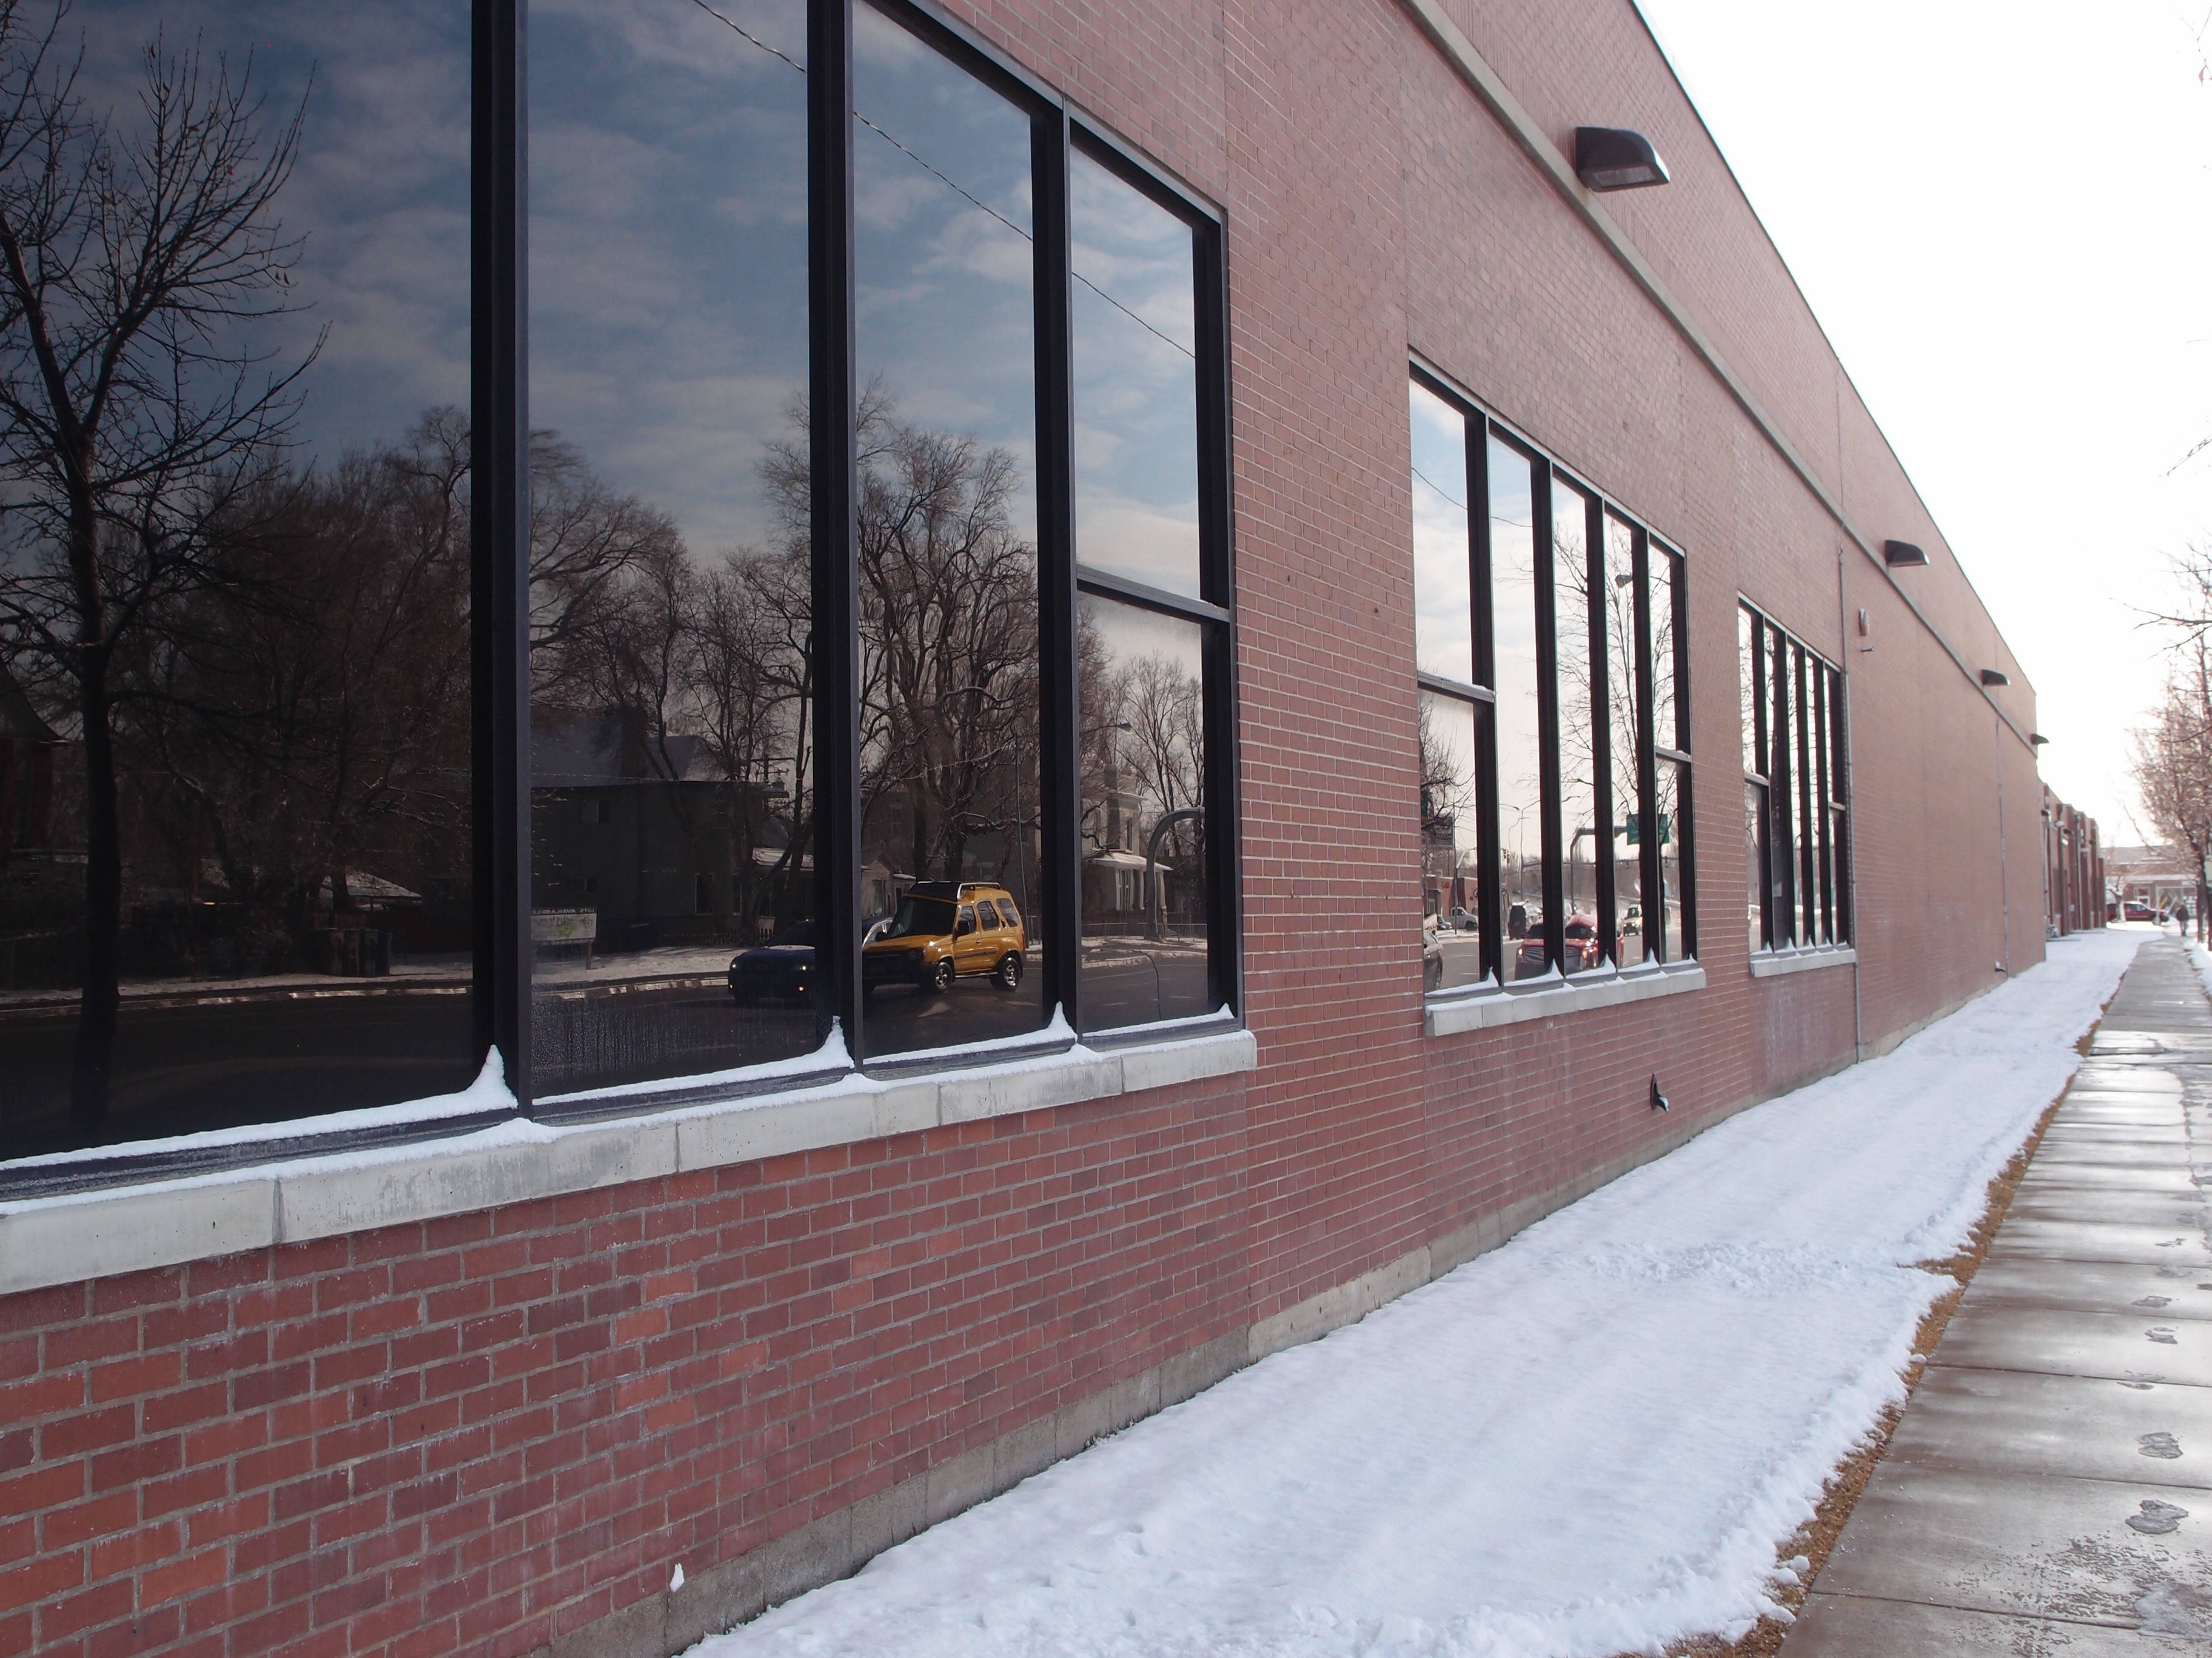
U of U Downtown Datacenter

Slide 10
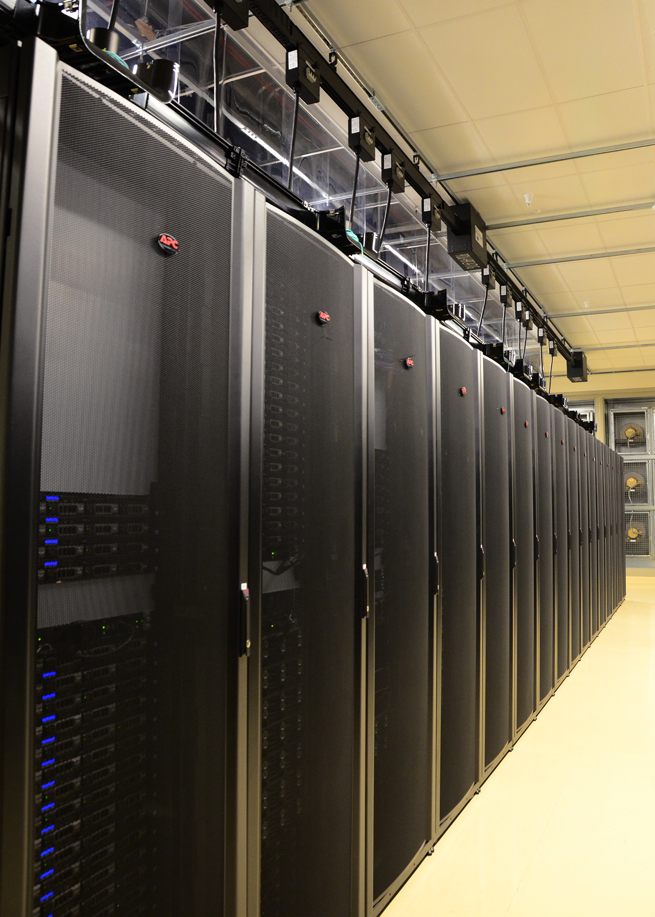
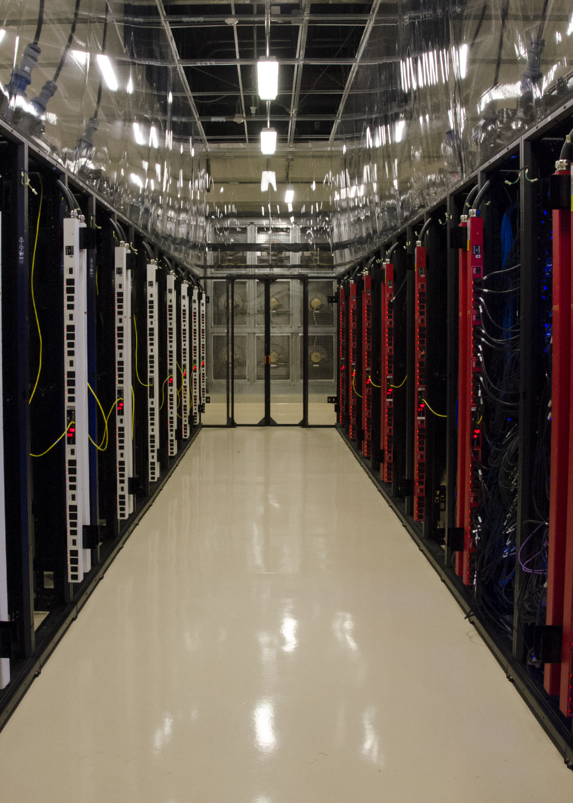
Downtown Data Center

Slide 11
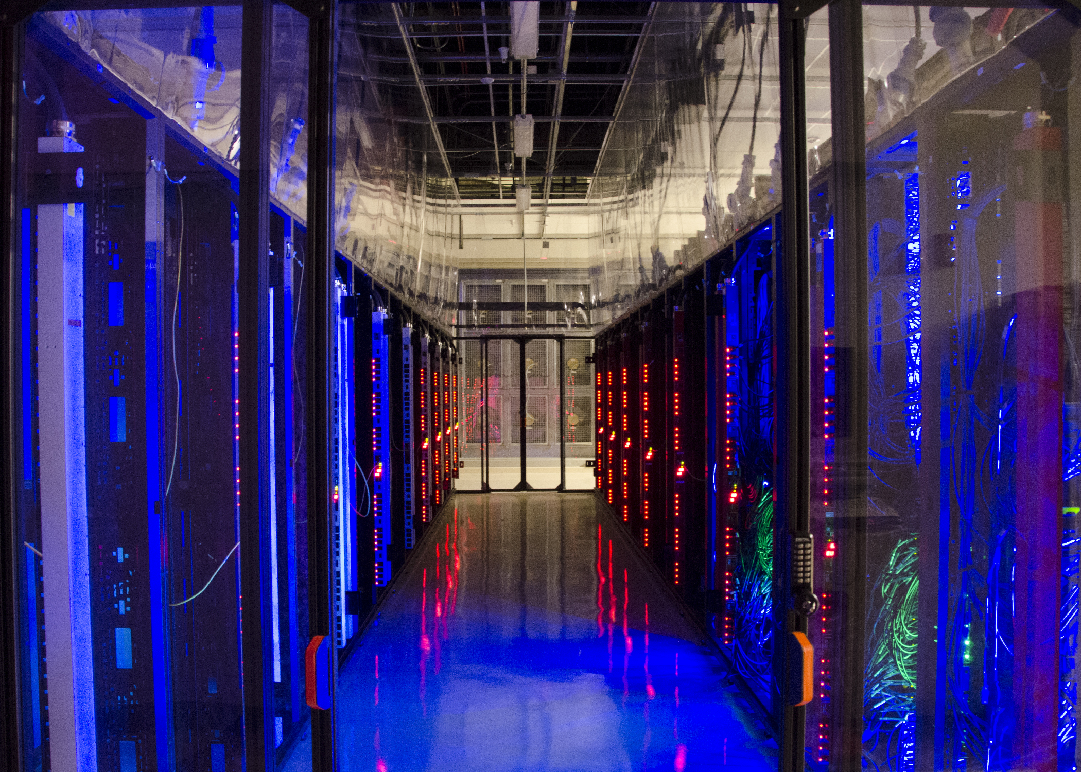

Slide 12
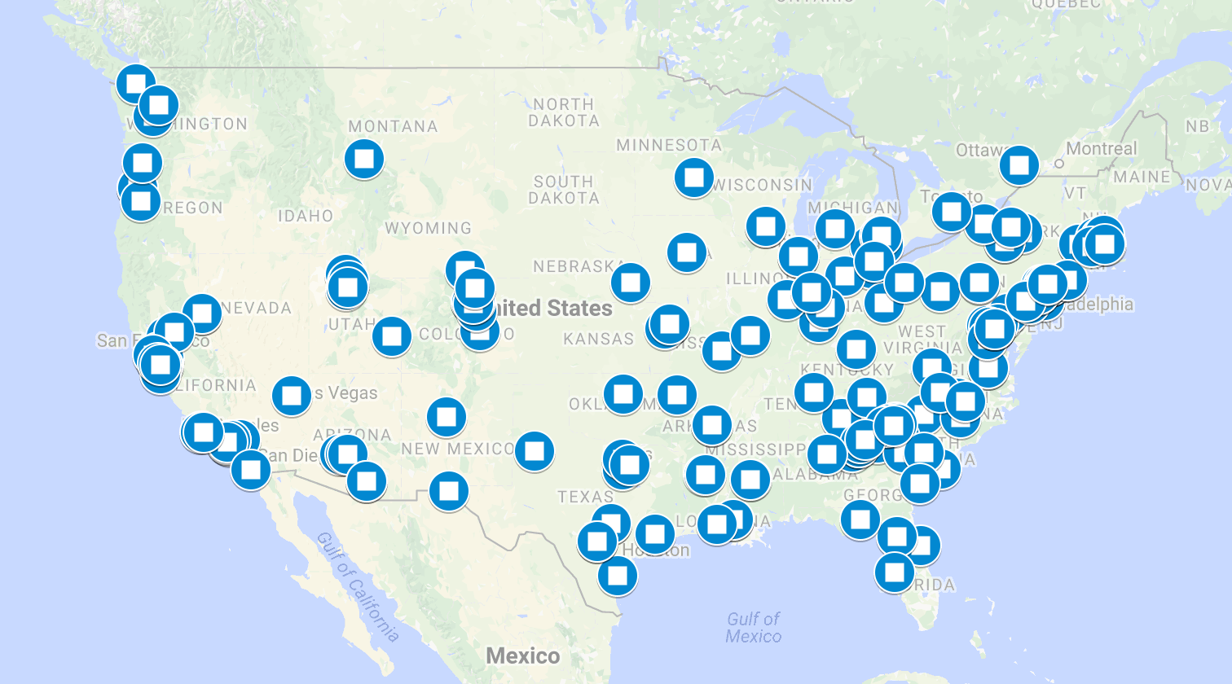
CloudLab Users So Far
May 2019:
858 projects
3,694 users
105,127 experiments

Slide 13
Research Made Possible
Building and improving hypervisors and other virtualization infrastructure
[Lim et al., SOSP ’17] [Liu et al., SIGCOMM ‘18]
Security: Testing attacks and defenses for the cloud
[Baek et al., SOCC ’18] [Shan et al., CCS ’17]
Low-latency networking (10s of μs) and RDMA
[Yoon et al., SIGMOD ’18] [Kulkarni et al., OSDI ’18] [Behrens et al., DSN ’18] [Gu et al. NSDI ‘17]
SDN: The whole stack, including hardware OpenFlow switches
[Li et al., SDN-NVF ’18] [Al-Kiswani et al., HPDC ’17] [Tasiopolous et al., IFIP ‘17]
Cloud control frameworks: studies that run their own clouds
[Du et al., CCS ’18] [Duplyakin et al., ScienceCloud ’17] [Mao et al., IPCCC ‘17]
Specialized topologies: control over cloud network topology
[Le et al., SOCC ’18] [Panda et al., NSDI ’17] [Liu et al., CoNext ‘15]

Slide 14
Example Case Studies
Kulkarni et al., OSDI 2018: “Splinter: Bare-Metal Extensions for Multi-Tenant Low-Latency Storage”
Requires low-level access to low-latency NICs for close database/NIC integration
Requires performance isolation to measure low latency and performance tails
Le et al., SOCC 2018: “RoGUE: RDMA over Generic Unconverged Ethernet”
Requires the ability to experiment with different switch QoS settings
Used CloudLab’s Layer-1 topology control and user-controlled switching
Lim et al., SOSP 2017: “NEVE: Nested Virtualization Extensions for ARM”
Requires ability to run on bare metal, modify the hypervisor
Used CloudLab’s ARM64 servers, as well as x86-64 servers

Slide 15
Building on Each Others’ Work

Slide 16
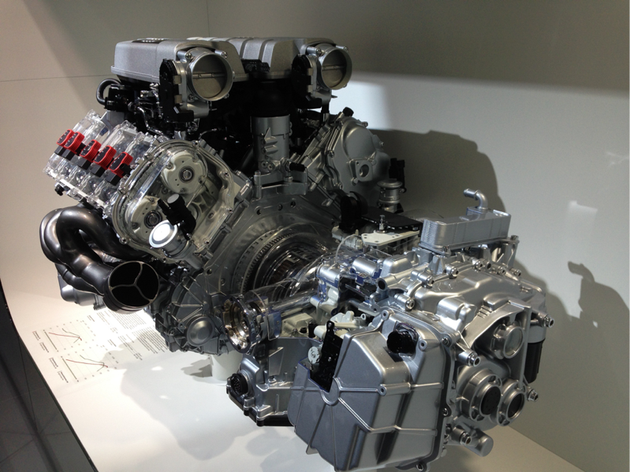

Slide 17
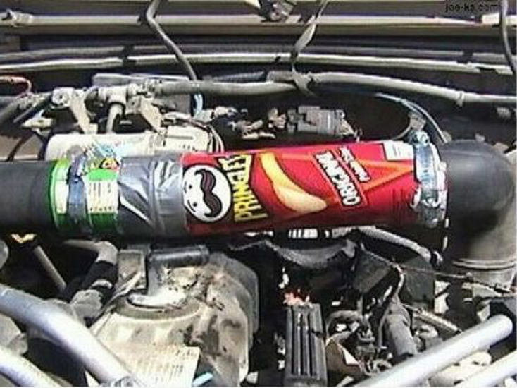

Slide 18
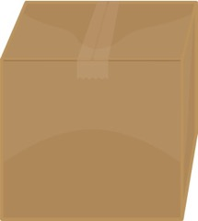

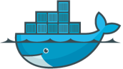

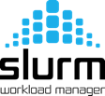
Profiles: Packaged environments
Your
Software
Here

Slide 19
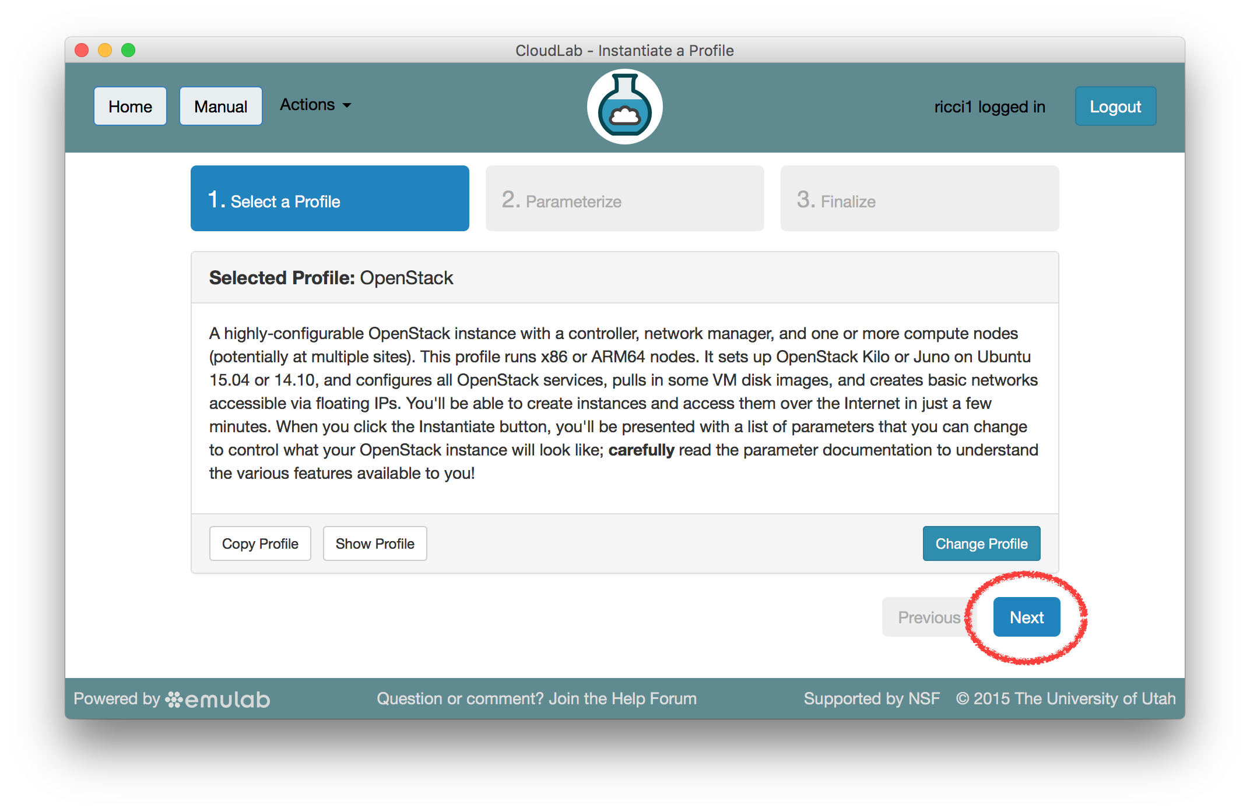
Your Own Cloud in One Click

Slide 20
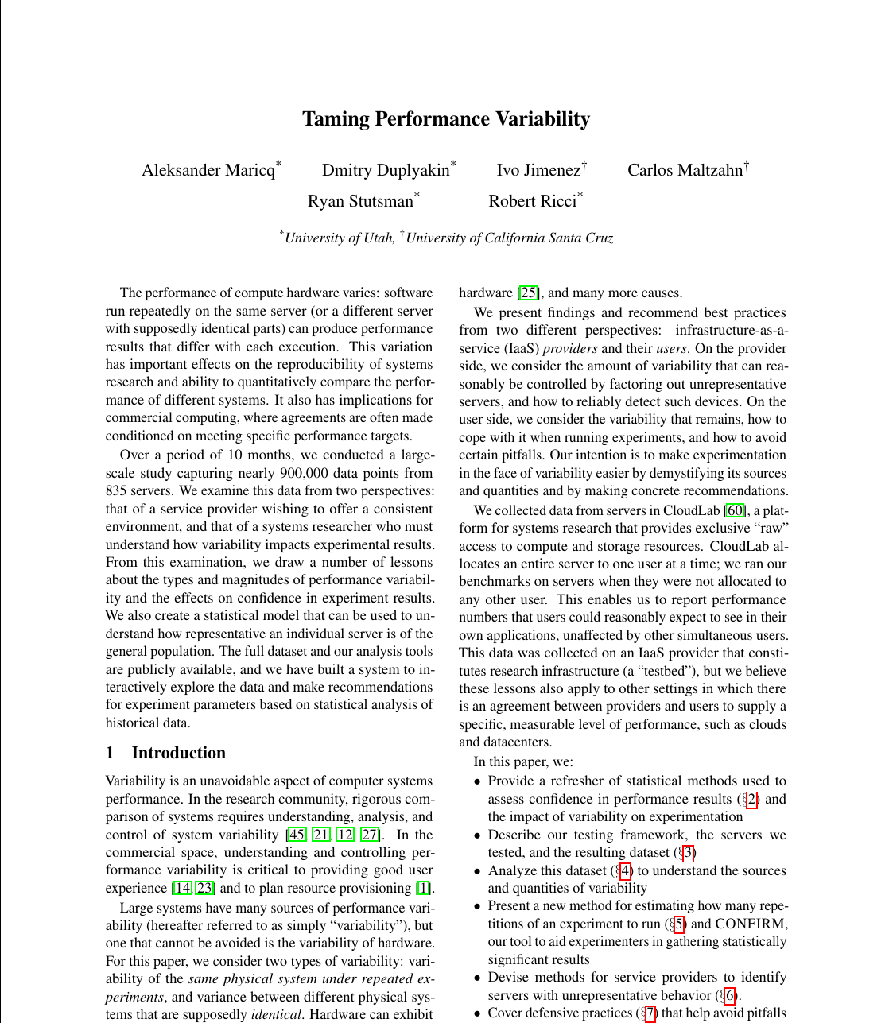

Slide 21
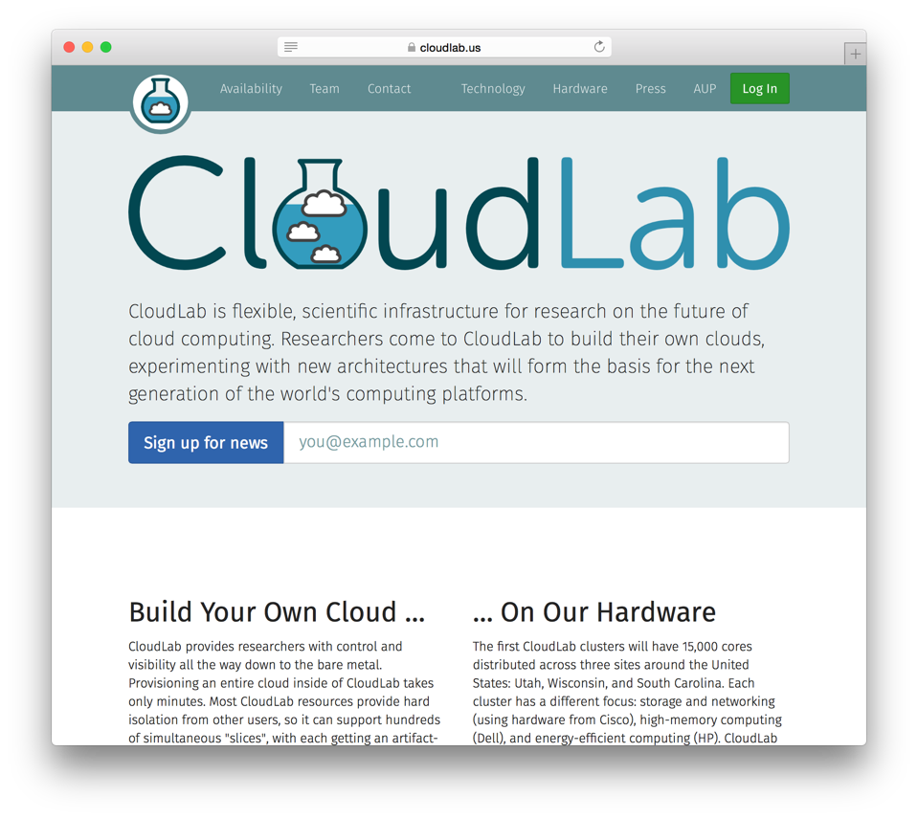
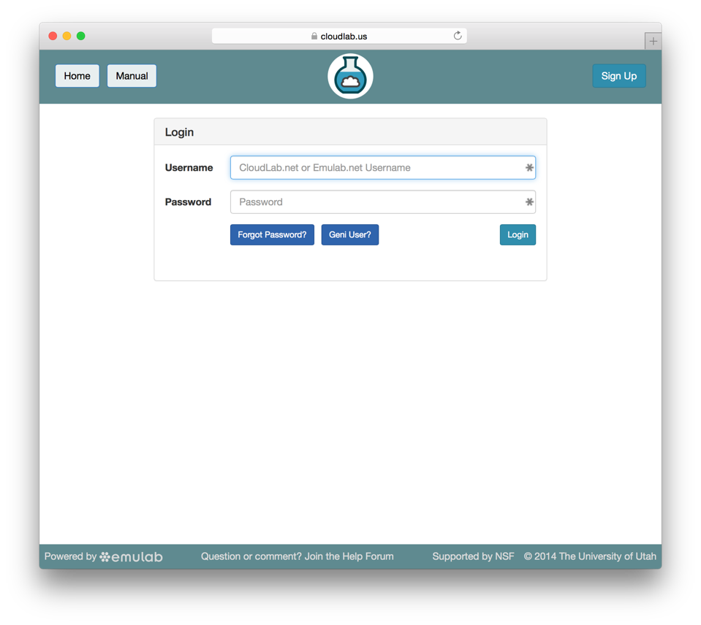
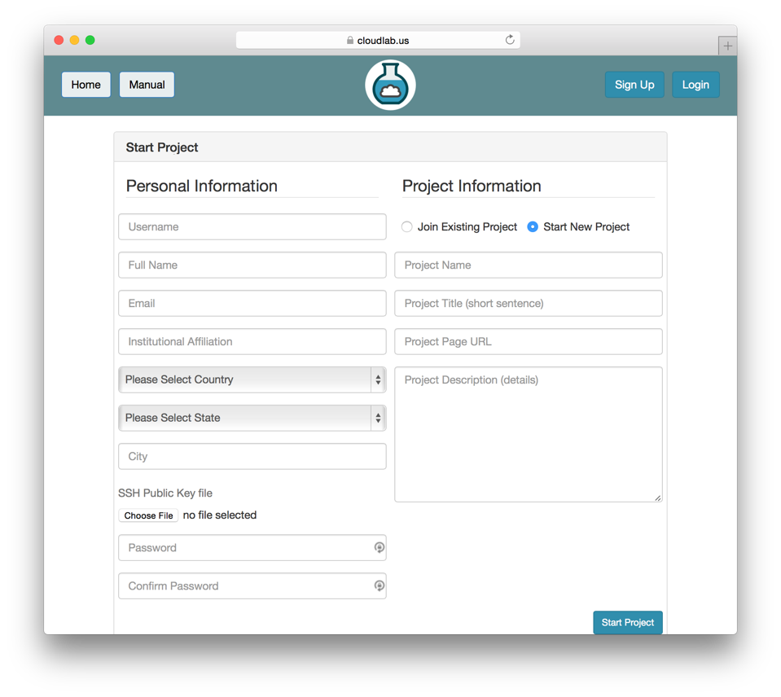
Sign Up At CloudLab.us

Slide 22



The CloudLab Team
Robert Ricci (PI)
Eric Eide
Steve Corbató
Kobus Van der Merwe
Aditya Akella (co-PI)
Remzi Arpaci-Dusseau
Miron Livny
KC Wang (co-PI)
Jim Bottum
Jim Pepin
Chip Elliott (co-PI)
Larry Landweber
Mike Zink (co-PI)
David Irwin
Glenn Ricart (co-PI)

Slide 23
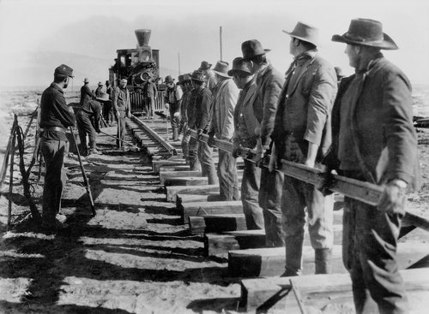

Slide 24
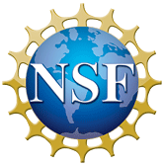
Learn more, sign up, share your research:
www.CloudLab.us
This material is based upon work supported by the National Science Foundation under Grant No. 1419199. Any opinions, findings, and conclusions or recommendations expressed in this material are those of the author(s) and do not necessarily reflect the views of the National Science Foundation.

